Slide 1

Mark1201: marketing Management
Figure 1. Hospitality. (“Cancongroup.com,” n.d.)
Lecture 6: Market Segmentation, Targeting, Research and Positioning

Slide 2
Market segmentation & Targeted marketing
Mass vs. Target Markets
Notes:
.

Slide 3
Mass Marketing
Historical approach, also called undifferentiated marketing
  Involves a haphazard approach to marketing
  Uses one strategy to reach the entire market
What are the pros and cons mass marketing in today’s environment?

Slide 4
4 Steps to Focused Marketing:
FOCUS:
SEGMENTATION
TARGETING
POSITIONING
MARKET RESEARCH
Figure 3. Focused Marketing. (“AdWeek,” 2017)

Slide 5
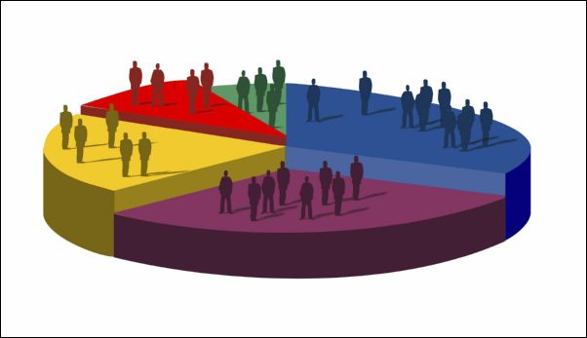
Market Segmentation
Categorizes the market into groups of potential buyers with similar characteristics
Groups of buyers that are similar enough that the same product or service will appeal to them
Also known as a target market
Figure 4. Market Segmentation. (“AdWeek,” 2017)

Slide 6
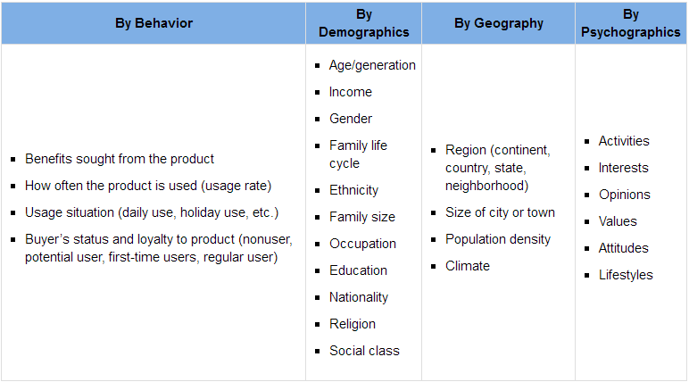
The Most Common Ways to Segment

Slide 7

BEHAVIOURAL SEGMENTATION
How do customers use our product, how do they behave towards it, and what benefits do they want?
Divides people and organizations into groups according to how they behave with or act toward products

Slide 8
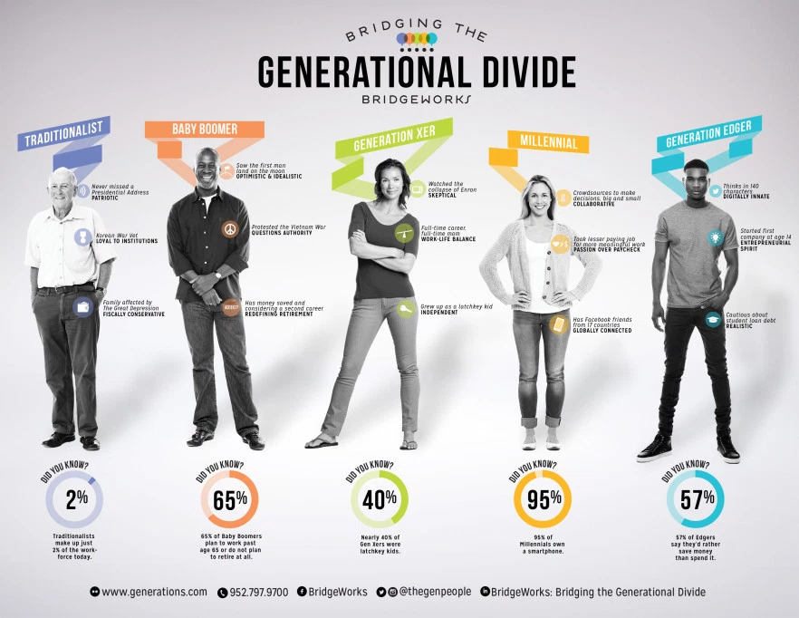
Demographic Segmentation:
How do the ages, races, genders, and ethnic backgrounds of our customers affect what they buy?
Figure 7: Generational Explanations. (Bridgeworks, 2015)
Notes:
Traditionalist:
Born 1922-1945
WWII, Pearl Harbor
Manufacturing developments
Created polio, tuberculosis, tetanus and whooping cough vaccines
Patriotic
Developed U.S. space program
Detail oriented, logical
Defined sense of right and wrong
Seek consistency and uniformity
Baby Boomer:
Born 1946-1964
Civil Rights Movement
Women's Movement
Vietnam War
Optimistic, confident
Consensus decision making
Largest living generation
Often portrayed as a generation of optimism, exploration and achievement.
Generation X
Born 1965-1980
Desktop PCs
First latchkey children
Entrepreneurial
Independent
Produce high-quality end results
Generation X felt the future had been given to their parents and older siblings and found the future disappointing and somewhat unappealing.
Gen Xers spent less time with their parents than previous generations of children had. First recognized as latchkey kids, this generation found themselves home alone and taking care of themselves and their siblings, while their parents worked. Divorce was common.
Generation Y or millennials
Born 1980-1994
Cable TV, computers, cell phones, Internet, text messaging
"Do we have a future?"
Columbine High School shootings
September 11, 2001
Close ties to parents
Team players
Accepting of diversity
Resilient
Well educated
Seek change & innovation
Generation Y’s Baby Boomer parents have nurtured and protected them, providing for their every emotional, educational and physical need and want.
They have praised and rewarded their children for minimal effort and have increased the expectations of school and community in educating, entertaining and protecting their children.
As a result, these young workers have high expectations of recognition and reward from others with minimal effort on their part.
Generation Edge
From 1995 to now
The youngest millennial is now 22
Children of the generation Xers
Achievement obsessed
Future focused – idealistic and optimistic
Technology aspirants
Extended adolescence
Born into a world on the edge of collapse (have only known recession and bleak growth)
This makes them resourceful as they are forced to think of alternative ways of making it in the world.
Easy access to information
Hospitality marketers are now recognizing the purchasing power of generation Xers and are looking to target them. This kind of segmenting is called:
Demographic
Geographic
Psychographic
Behavioural

Slide 9
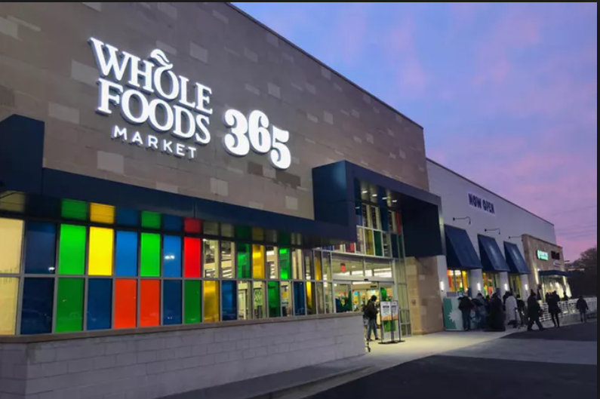
Demographic Segmentation: Income
Figure 7. Whole Foods Market 365. (TastingTable, 2017)
Notes:
(Whole Foods 365)
http://fortune.com/2016/05/25/whole-foods-new-cheaper-chain-launches-today/

Slide 10
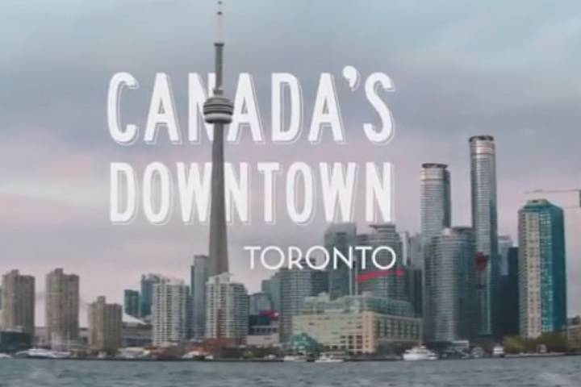
By Geography
Where are our customers located? What products do they buy based on their locations?
Figure 9. Tourism Toronto (“Canada’s Downtown,” 2017)

Slide 11

By Psychographics
How do our customers live their lives? What do our customers think about and value?
Figure 10.G Adventures. (“Change the World,” 2016)
Notes:
VALS (Values & Lifestyles)

Slide 12
Other Ways to Segment Markets
PURPOSE OF TRIP
PRODUCT-RELATED
DISTRIBUTION CHANNEL
Figure 5. Market Segments. (“The Star,” 2010)

Slide 13
For Example: Marriott
Marriott Courtyard.
Ritz-Carlton Hotels.
Marriott Conference Centers.
Marriott ExecuStay.
Marriott Vacation Clubs.
Targeted at over-the-road travelers.
Targeted at luxury travelers.
Targeted at businesses hosting small- and midsized meetings.
Targeted at executives needing month-long accommodations.
Targeted at travelers seeking to buy timeshares.
Figure 12. Marriott Brands. (“Marriott,” 2017)
Notes:
Example of product related.

Slide 14

Targeted Marketing
MARKET SEGMENTATION involves those processes of slicing and dicing the market
TARGETED MARKETING focuses marketing efforts on (a) specific market segment(s), called a TARGET MARKET
Figure 11. Target Market. (“AdWeek,” 2017)

Slide 15

Define A Target (Market) Audience
As a Marketer, ask yourself:
Am I looking at the consumes the way they see themselves?
Am I looking at life from their point of view?
Figure 13: Personas (Skinner, 2016)

Slide 16
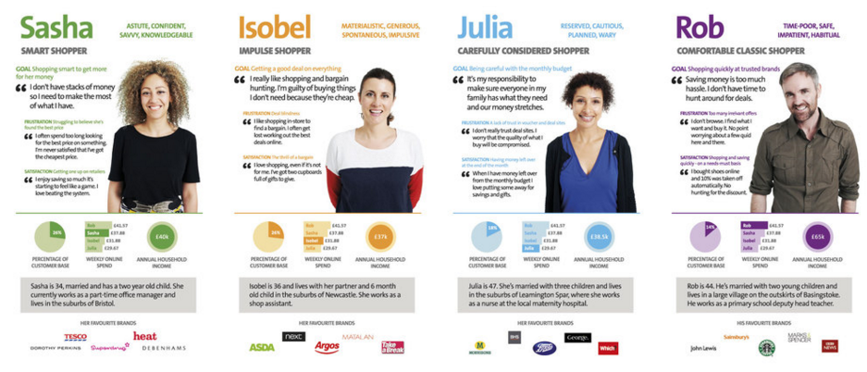
Shopper personas – Walmart
Figure 14: Personas Example. (“lightpetal,” n.d.)
Notes:
Great read about how to use personas in your Marketing Plan: https://www.linkedin.com/pulse/4-starter-personas-tourism-travel-content-market
Xtensio’s User Persona Creator is a neat app that allows you to enter your buyer persona’s demographics, goals, frustrations, bio, motivations, preferred channels and brands. Register for a free account.

Slide 17
Segmenting and Target Marketing Benefits
Competition
Avoid head-on competition with other firms trying to capture the same customers.
Create New Opportunities
Develop new offerings and expand profitable brands and products lines.
Remarket older products and brands.
Identify early adopters.
Customer Retention
Focus on your most profitable customers.
Retain “at-risk” customers in danger of defecting to your competitors.

Slide 18
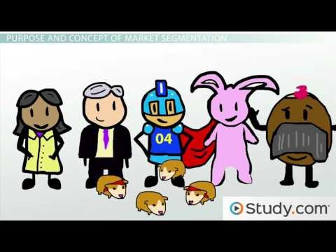
Marketing Segmentation Defined
Luitel, P. [peter luitel]. (2016, February 26). Market Segmentation Why Market Segments Are Important [Video file]. Retrieved from https://www.youtube.com/watch?v=D8oVKRNSWBc
Notes:
To help summarize: https://www.youtube.com/watch?v=D8oVKRNSWBc

Slide 19
Market research & positioning

Slide 20
4 Steps to Focused Marketing:
FOCUS:
SEGMENTATION
TARGETING
POSITIONING
MARKET RESEARCH
Figure 3. Focused Marketing. (“AdWeek,” 2017)

Slide 21

Market Research
Defines a marketing PROBLEM or OPPORTUNITY by systematically collecting and analyzing information
Assesses the NEEDS and WANTS of consumers and provides information to help design an organization’s marketing program
Figure 13. Market Research (“AdWeek,” 2017)

Slide 22
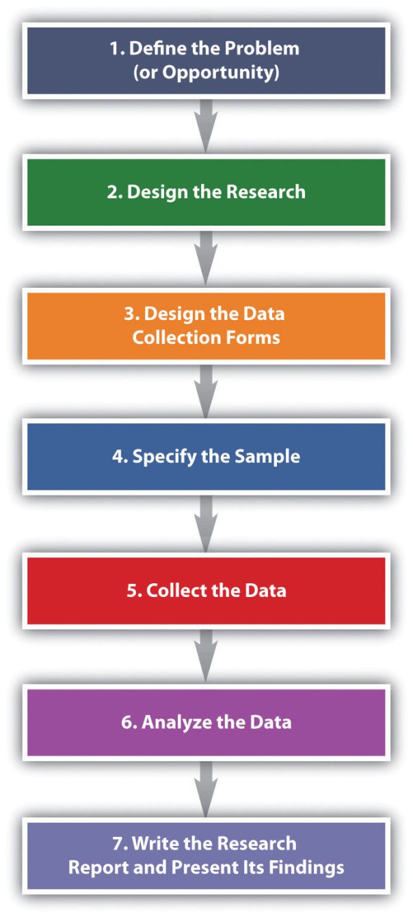
MARKET RESEARCH
The seven steps to conducting marketing research

Slide 23
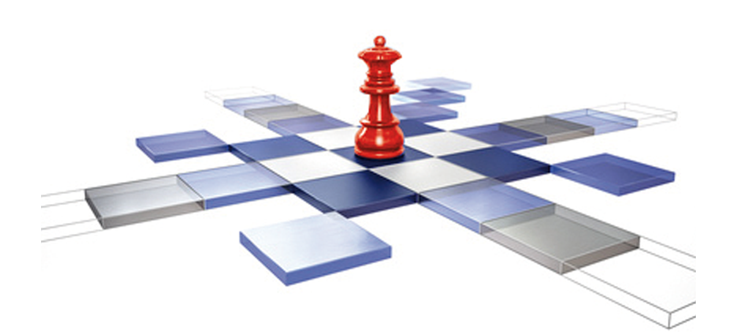
Positioning
Positioning is how consumers PERCEIVE a product relative to the competition.
Companies want to STAND OUT from the competition in the minds of consumers.
Figure 15. Market Segmentation. (“AdWeek,” 2017)

Slide 24
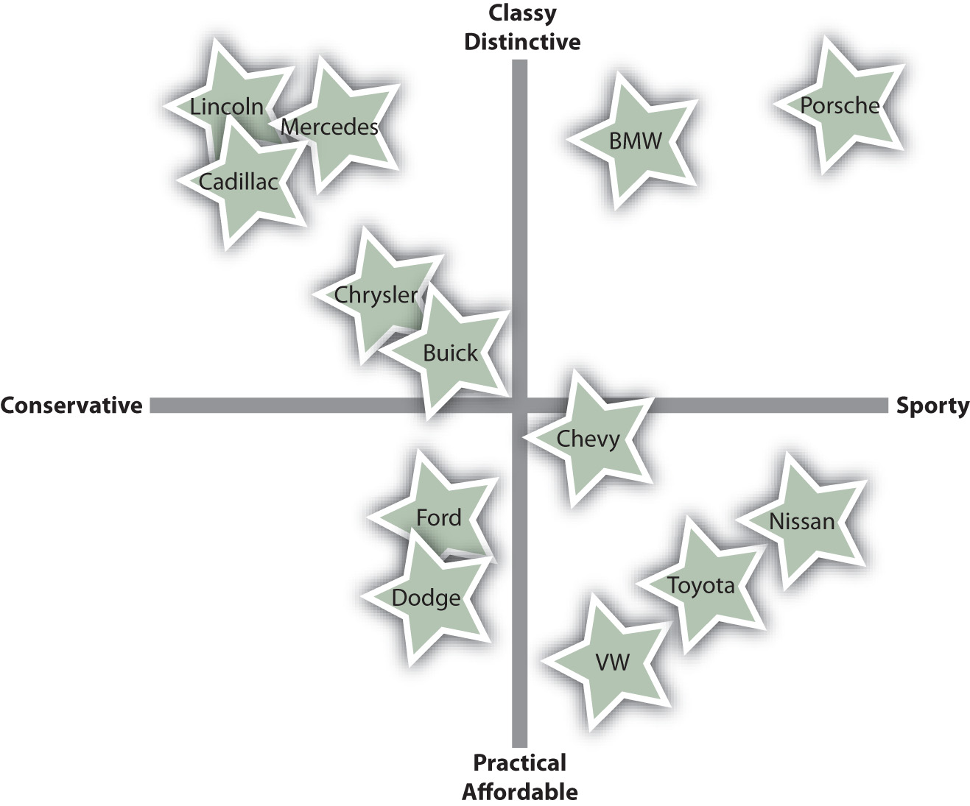
PERCEPTUAL MAP
Ideally, you want to position your product on the map where your competitors aren’t clustered

Slide 25
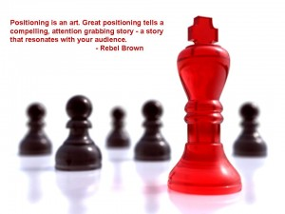
POSITIONING STATEMENT
By crafting a positioning statement, you tell your customers the value you give them by choosing your product over a competitor’s.
Figure 16. Positioning Statement. (“AdWeek,” 2017)

Slide 26
Positioning Statement: 3 Steps
Step 1
Step 2
Step 3
Address your target market
Show the unique value you provide for them
Demonstrate why they should believe you
[Brand Name] provides ___(1)___ with ___(2)___ than any other [Your Industry]. We do this by ___(3a)___, ___(3b)___, and ___(3c)___.

Slide 27
As a Result…
Brice Co. provides Men ages 24 -35 with lower prices on sporting goods than any other sporting goods store. We do this by eliminating overhead, forming strategic partnerships with major brands, and matching any other price on the web.

